Slide 1
Model Basics and Building
Victoria’s not so secret Models
Notes:
https://www.tmwr.org/resampling.html
http://journal.embnet.org/index.php/embnetjournal/article/view/550

Slide 2
Workshop Objective
Understanding the concepts of a data Model (as Model for understanding data and interpreting data, and not in structuring data for databases)
Understand the needs to tidying up data prior to modelling data
Know the name of the data model and one of the libraries that allow you to use such model
Conceptualised the typical example and intentional use case for each models
Benefits and Limitation of each models

Slide 3
Data Model Definition
A data model (or datamodel) is an abstract model that organizes elements of data and standardizes how they relate to one another and to the properties of real-world entities.
For instance, a data model may specify that the data element representing a car be composed of a number of other elements which, in turn, represent the color and size of the car and define its owner.
Notes:
https://en.wikipedia.org/wiki/Data_model

Slide 4
Data Model (Sometimes also used to refer to Data Structure)
For example, the storage structure of experiment data as an SE objects can also be called a type of “Data Model”
We are not talking about those here, but rather, we will be talking about statistical models
Notes:
https://en.wikipedia.org/wiki/Data_model

Slide 5
Why do we use Data Model
Data is more important than algorithm
To characterize numerical data
To help estimate uncertainties in observational data and uncertainties
To characterize numerical output from mathematical models to help understand the behavior
To estimate probabilistic future behavior of a system based on past statistical information, a statistical prediction model.
To extrapolation or interpolation of data based on a linear fit (or some other mathematical fit) are also good examples of statistical prediction models.
To estimate input parameters for more complex mathematical models.
To obtain frequency spectra of observations and model output.
Notes:
https://www.guru99.com/data-modelling-conceptual-logical.html
https://serc.carleton.edu/introgeo/mathstatmodels/why.html

Slide 6
Common of Data Model
Regression/Classification model
Clustering model
Forecast model
Notes:
https://www.datasciencecentral.com/profiles/blogs/top-20-uses-of-statistical-modeling

Slide 7
Regression/Classification model
Linear Regression (GLM)
Logistic Regression
K-Nearest Neighbors (KNN)
Decision Tree
Random Forest
Support Vector Machine
Notes:
https://www.datasciencecentral.com/profiles/blogs/top-20-uses-of-statistical-modelling
https://analyticsindiamag.com/7-types-classification-algorithms/

Slide 8
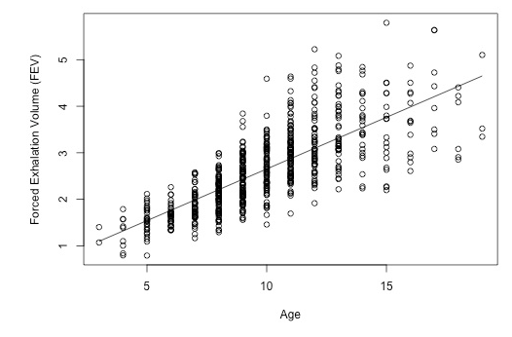
1.1 Linear Regression
https://online.stat.psu.edu/stat462/node/101/

Slide 9
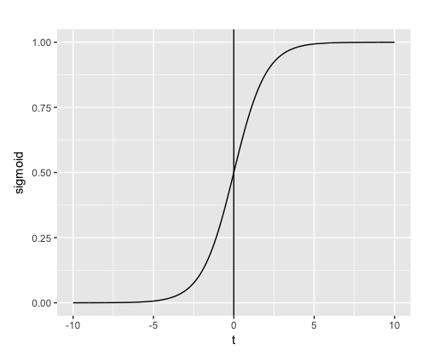
1.2 Logistic Regression
https://www.guru99.com/r-generalized-linear-model.html

Slide 10
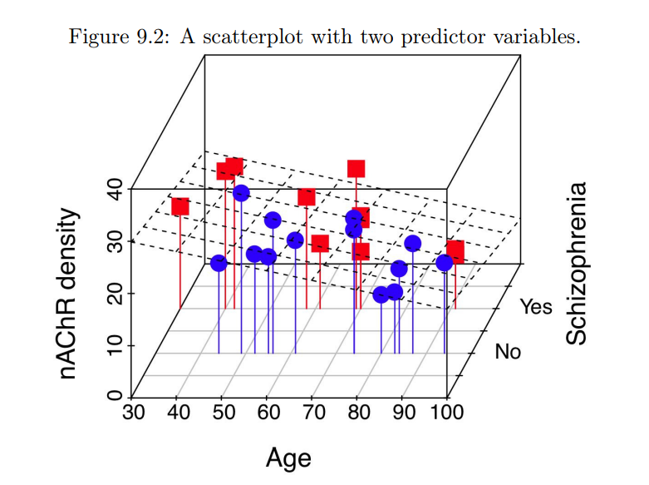
1.2.1 Generalized Linear Model (Ridge, Lasso, Elastic net)
http://psych.colorado.edu/~carey/qmin/qminChapters/QMIN09-GLMIntro.pdf
Notes:
Generalized linear modeling is a framework for statistical analysis that includes linear and logistic regression as special cases. Linear regression directly predicts continuous data y from a linear predictor Xβ = β0 + X1β1 + ··· + Xkβk. Logistic regression predicts Pr(y = 1) for binary data from a linear predictor with an inverselogit transformation.

Slide 11
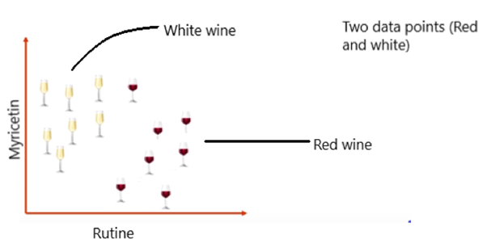
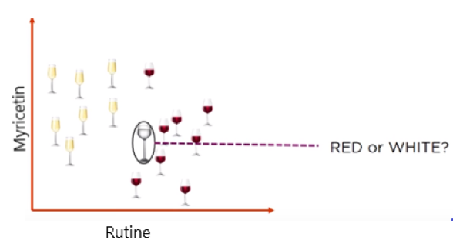
1.3 K-Nearest Neighbors (KNN)
“‘k’ in KNN is a parameter that refers to the number of nearest neighbours to include in the majority of the voting process.
Suppose, if we add a new glass of wine in the dataset. We would like to know whether the new wine is red or white?
So, we need to find out what the neighbours are in this case. Let’s say k = 5 and the new data point is classified by the majority of votes from its five neighbours and the new point would be classified as red since four out of five neighbours are red.”
-- https://towardsdatascience.com/a-simple-introduction-to-k-nearest-neighbors-algorithm-b3519ed98e
Notes:
https://towardsdatascience.com/knn-algorithm-what-when-why-how-41405c16c36f
https://towardsdatascience.com/a-simple-introduction-to-k-nearest-neighbors-algorithm-b3519ed98e

Slide 12
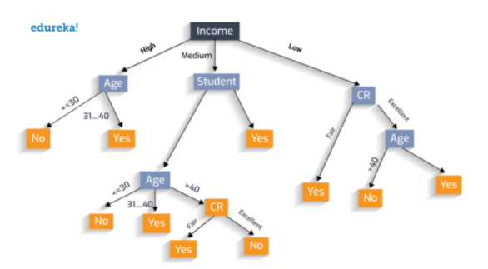
1.4 Decision Tree
https://blog.davidvassallo.me/2019/08/06/3-uses-for-random-decision-trees-forests-you-maybe-didnt-know-about/

Slide 13
1.5 Random Forest
https://blog.davidvassallo.me/2019/08/06/3-uses-for-random-decision-trees-forests-you-maybe-didnt-know-about/

Slide 14
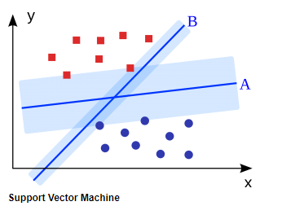
1.6 Support Vector Machine
https://favouriteblog.com/machine-learning-algorithms-which-one-to-choose-for-your-problem/

Slide 15
2. Clustering model
Hierarchical
Principle Component Analysis
T-SNE
UMAP
K Means
Notes:
https://www.datasciencecentral.com/profiles/blogs/top-20-uses-of-statistical-modeling

Slide 16
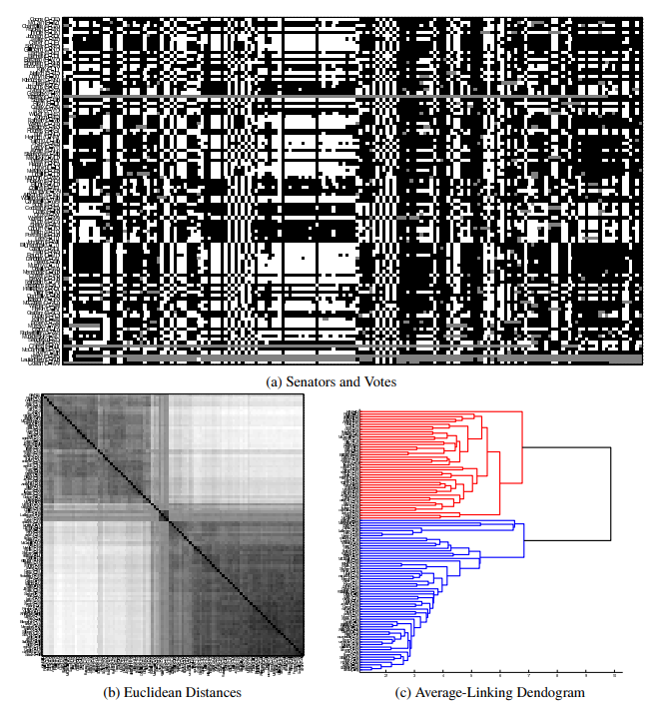
2.1 Hierarchical Clustering
https://www.youtube.com/watch?v=7xHsRkOdVwo
https://www.cs.princeton.edu/courses/archive/fall18/cos324/files/hierarchical-clustering.pdf

Slide 17
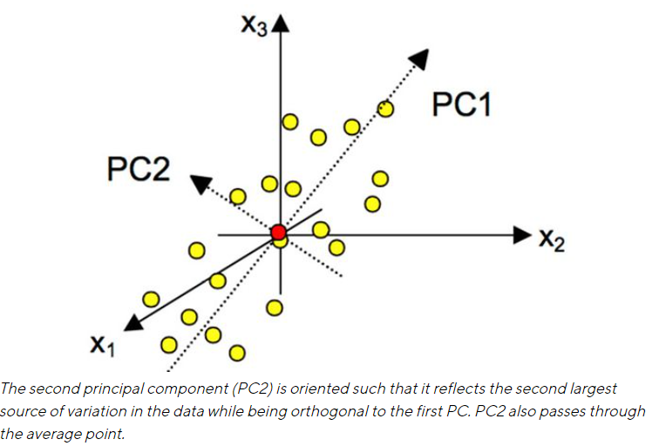
2.1 Principle Component Analysis
https://www.sartorius.com/en/knowledge/science-snippets/what-is-principal-component-analysis-pca-and-how-it-is-used-507186

Slide 18
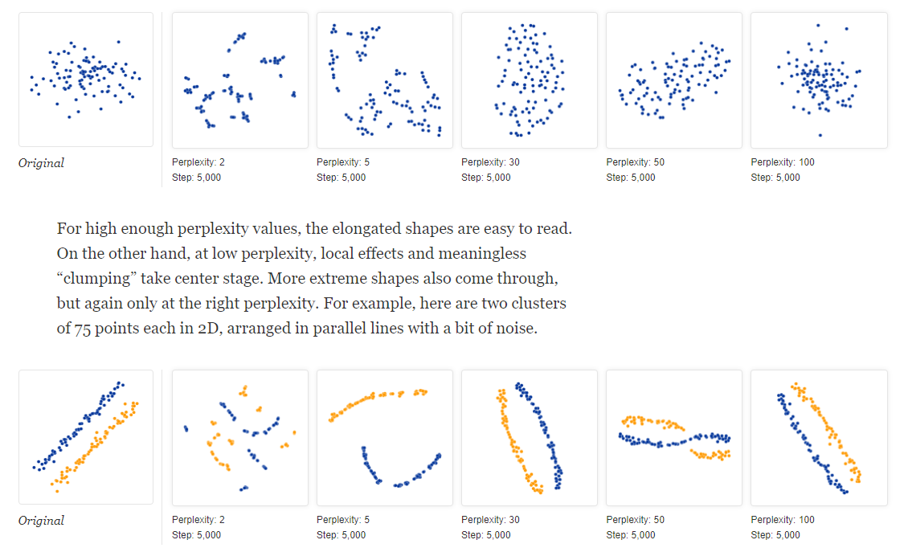
2.3 t-SNE
(t-distributed stochastic neighbor embedding)
https://distill.pub/2016/misread-tsne/

Slide 19
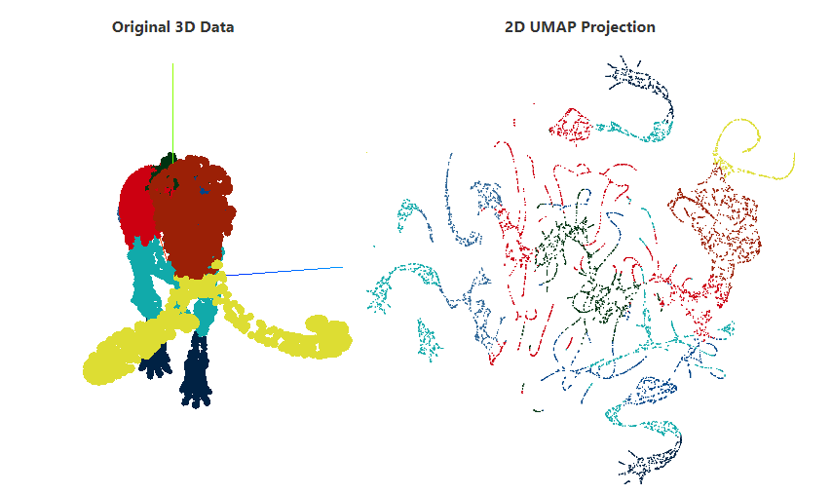
2.4 UMAP
Uniform Manifold Approximation and Projection for Dimension Reduction
https://pair-code.github.io/understanding-umap/

Slide 20
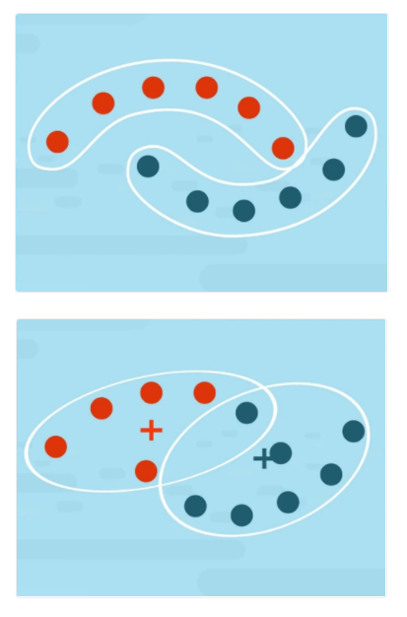
2.4 K-means clustering
https://365datascience.com/tutorials/python-tutorials/k-means-clustering/

Slide 21
3. Forecast model (Predictive Models)
Neural Network?
MLP (Multilayer Perceptron)
Convolutional
Recurrent
Auto-encoder (Classification and Dimensional Reduction)
Etc (RBM, Transformer, and many more)
Notes:
https://towardsdatascience.com/types-of-neural-network-and-what-each-one-does-explained-d9b4c0ed63a1

Slide 22
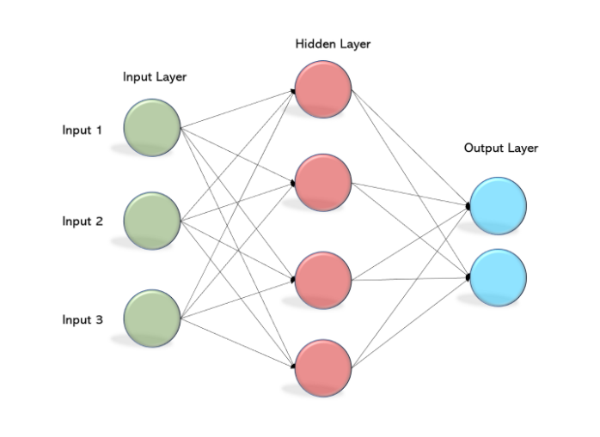
3.1.1 MLP (Multilayer Perceptron)
https://becominghuman.ai/multi-layer-perceptron-mlp-models-on-real-world-banking-data-f6dd3d7e998f

Slide 23
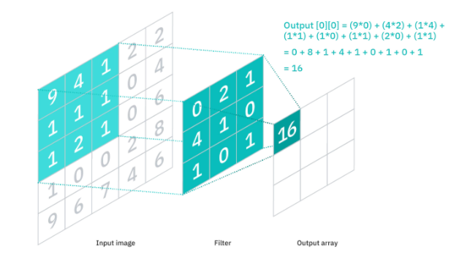
3.1.2 Convolutional Neural Network
https://www.ibm.com/cloud/learn/convolutional-neural-networks
https://deepai.org/machine-learning-glossary-and-terms/convolutional-neural-network

Slide 24
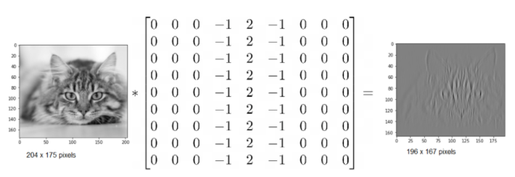
3.1.2 Convolutional Neural Network
https://www.ibm.com/cloud/learn/convolutional-neural-networks
https://deepai.org/machine-learning-glossary-and-terms/convolutional-neural-network

Slide 25
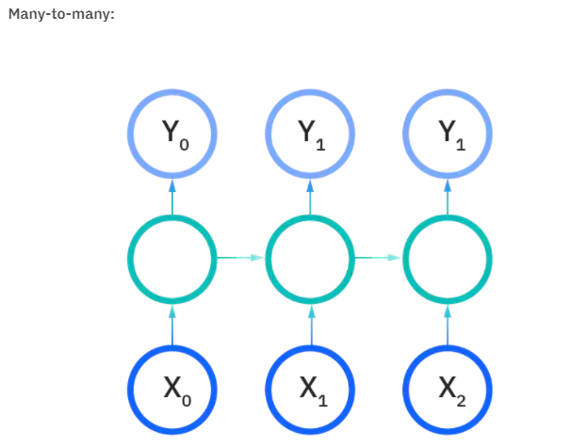
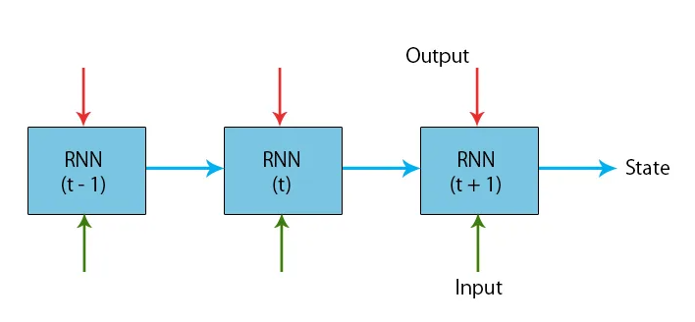
3.1.3 Recurrent Neural Network
https://www.ibm.com/cloud/learn/recurrent-neural-networks
https://www.educba.com/recurrent-neural-networks-rnn/

Slide 26
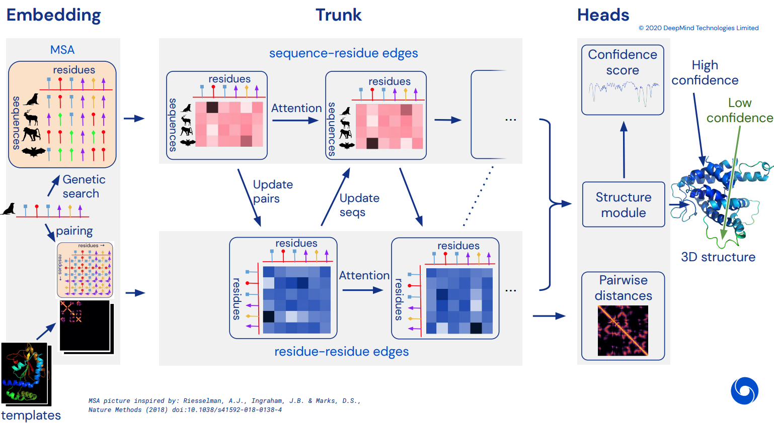
3.1.2 Transformer (AlphaFold2)
Notes:
https://github.com/lucidrains/alphafold2

Slide 27
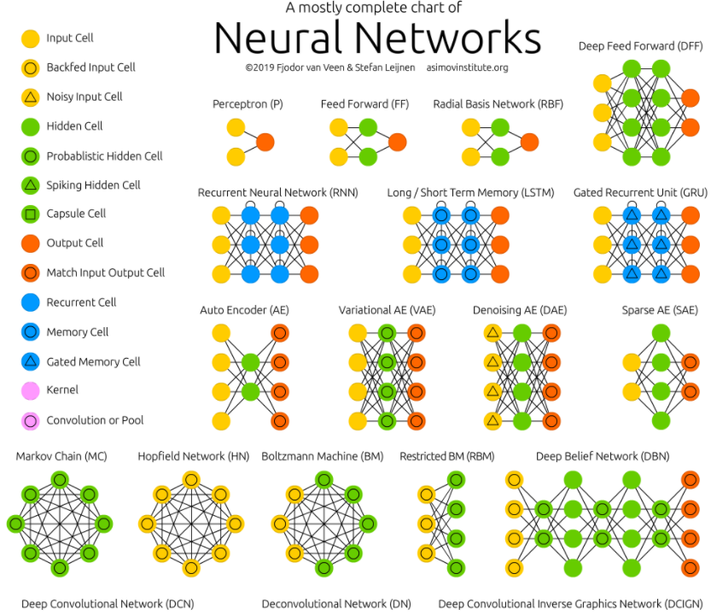
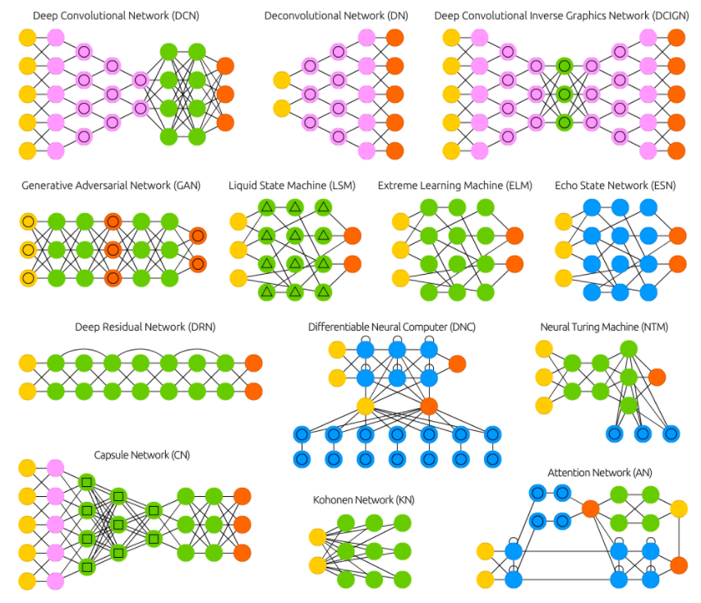
3.1.2 Etc (RBM, Transformer, and many more)
https://www.asimovinstitute.org/neural-network-zoo/

Slide 28
Finally to wrap it all up
1. How to properly install R, Rstudio, and libraries
2. How to get packages from Bioconductor
3. How to import data into the R environment
4. What’s data type, what's data structure
5. How to filter data (rows) using indices and dplyr

Slide 29
Finally to wrap it all up
6. How to subset data (columns) using indices and dplyr
7. How to draw a plot in baseR and using gglot2?
8. What plot to draw for what data？
9. When do you have too little data and when do you have too much data on a single plot
10. When do you need to use loops?

Slide 30
Finally to wrap it all up
11. When do you need pipes?
12. When someone give you a dataset, do you know how to get a visualization out? and what would be a correct graph to give?
13. Which model or analysis summary you will use that can best explain the dataset?

